Slide 1


Slide 2

Gradient Descent

Slide 3

Gradient Descent
In machine learning we dont always have closed form solution
Closed form solution example: β=(X′X)⁻¹X′Y
In the absence of a closed form solution/global minimum, the best approximation is some local minima.
Let us look at an example

Slide 4
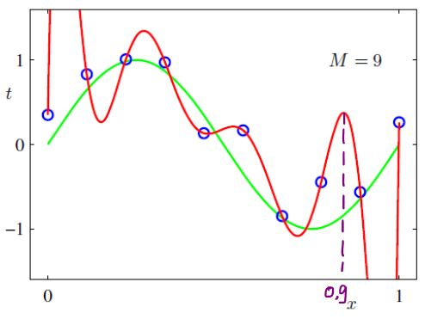
Function with no global minimum/max

Slide 5
Function with no global minimum/max
Such situation are common when dealing with complex nonlinear relationships.
So, how do we find the next lowest value/local minimum?
Simple. Trial and Error!
Lets check it out using linear regression. Note, while linear regression is a good way to demonstrate the use of gradient descent, it is rarely used to solve linear equations.

Slide 6
Function with no global minimum/max
Lets take a two variable example.
65 = B₀+B₁7.5 + e
updation of B rule
alpha = 0.001
error - 26.5
B = 5
B(t+1) = B_{t = 0} - alpha * error
Our data is: get dataset

Slide 7
Function with no global minimum/max
So lets start by initializing some beta values and make a prediction
Ok, we got a bad prediction. But lets find a way to use this error.
Let’s use the example of a blind-folded person at the top of a mountain. How will he/she come down?

Slide 8
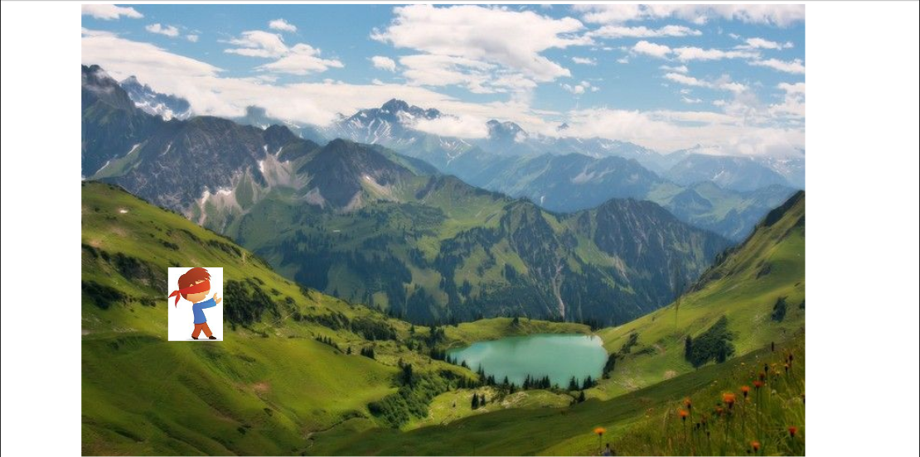
Gradient Descent: Down a Mountain

Slide 9
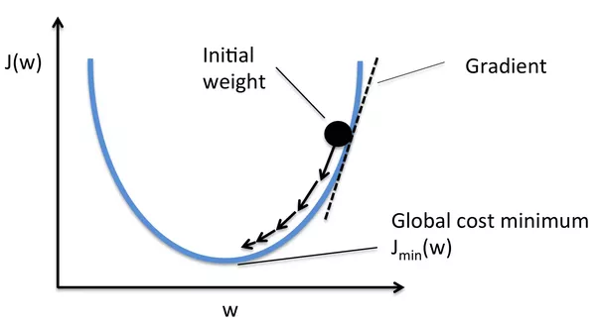
Function with no global minimum/max

Slide 10


